Slide 1
social media
monke & monke

Slide 2
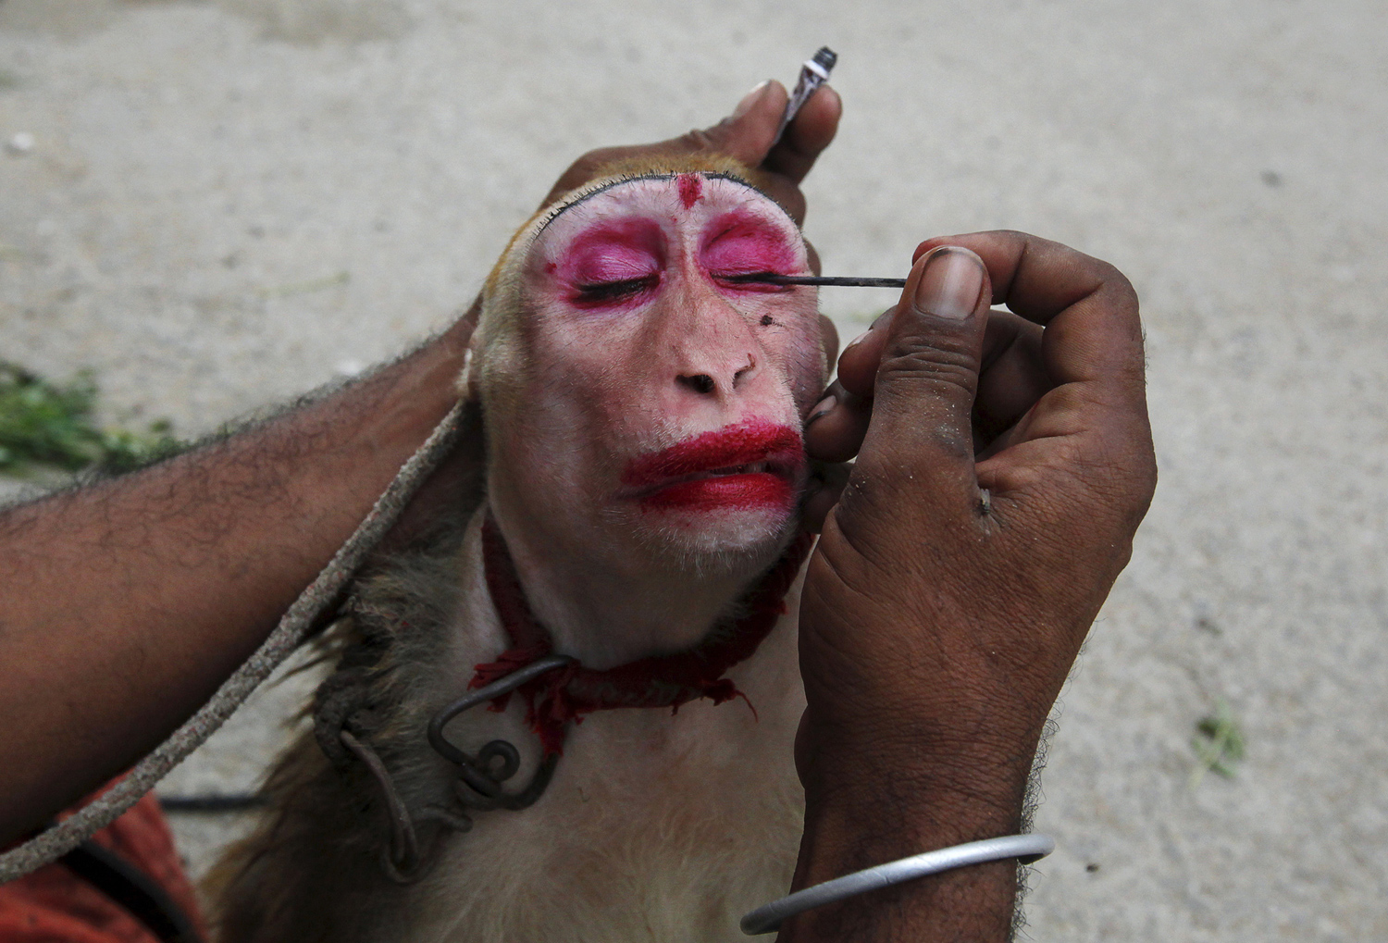
this is #me

Slide 3
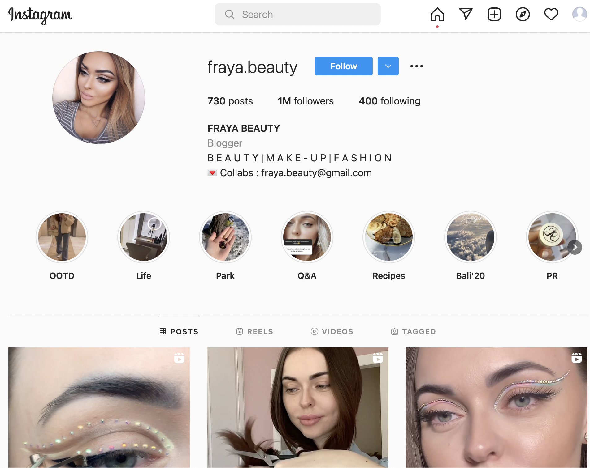
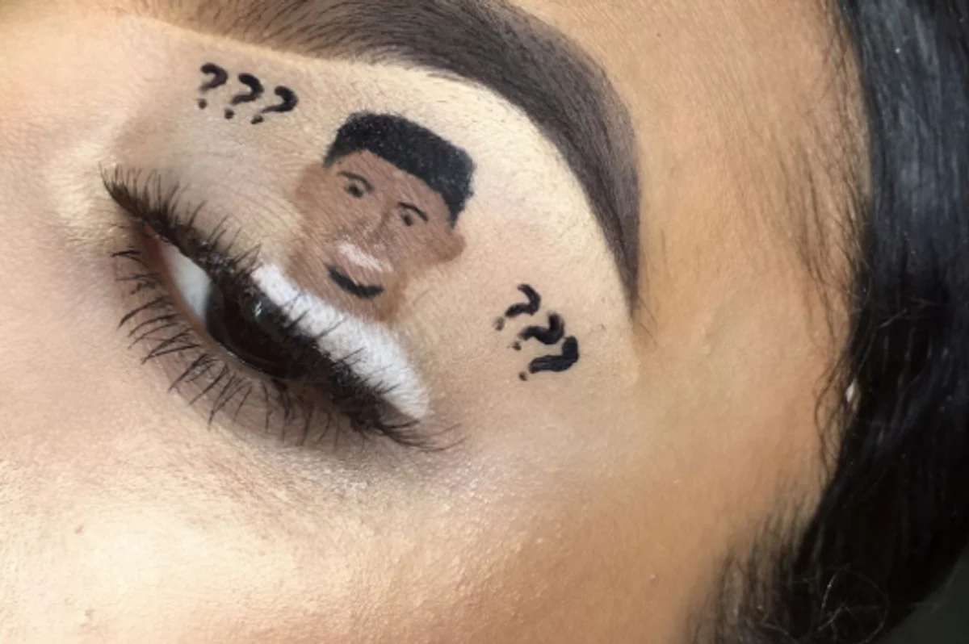

business model & structure
monke & monke
content driven partnership
user base
video production
#relatability
monke monke

Slide 4
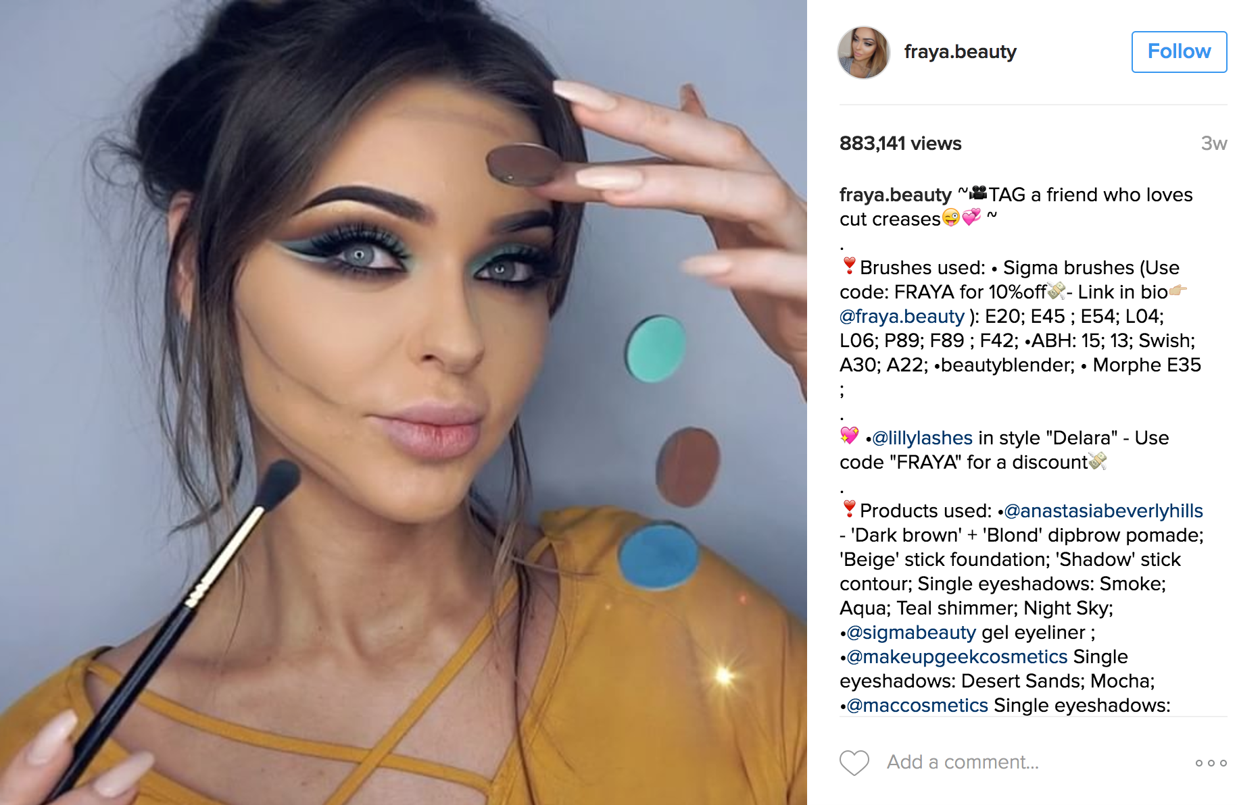
description of business value & workflow
monke & monke
bottom text
monke monke

Slide 5
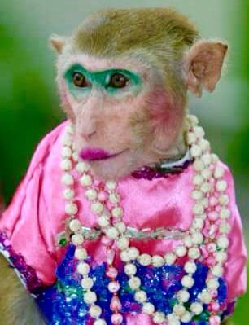

business critical assets
Personal account access
username and password
Contracts with companies
partnerships
Authenticity
followers
private personal information
Full time staff
Email accounts
monke monke

Slide 6
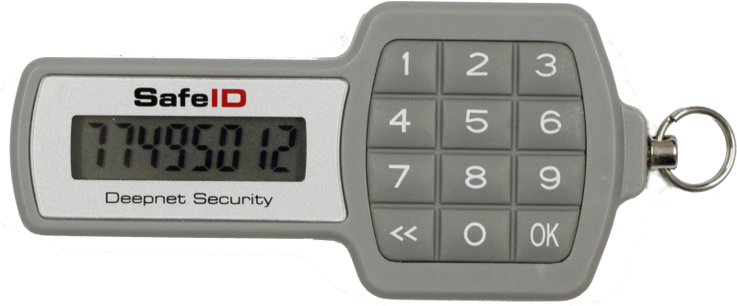
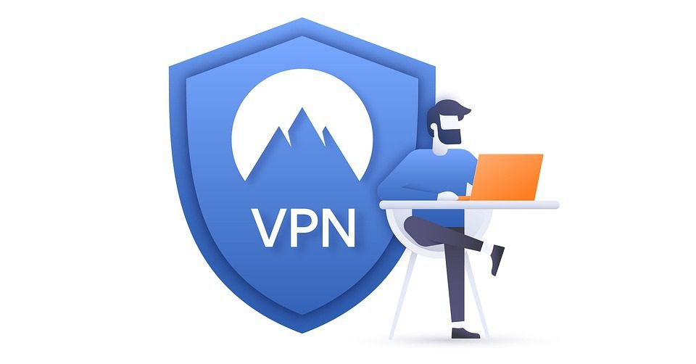
our solutions
Personal account access
username and password - Two Factor authentication and complexify the pwd with a random token
Only allow one phone to have access to the account, and it is stored in business location
Traceability of account activity sent as logs to business email
VPN, antivirus for private personal account
Contracts with companies
Business email - Two Factor authentication and complexify the pwd with a random token
Detect fake company partnerships via training on authenticity research
Authenticity
Disclose false followers and terminate such accounts
Fake alt. accounts and comment bot spams reported
Redact all public information aggregated by websites
Full time staff
VPN, antivirus software to prevent when file transferring to main account
Security camera in production offices
Traceability of account activity sent as logs to business email
Training on social engineering and phishing
Detect and report bribes
monke monke

